Slide 1

Agent-based modelling of Language development on St. Thomas
Centre for
Educational Development

Slide 2
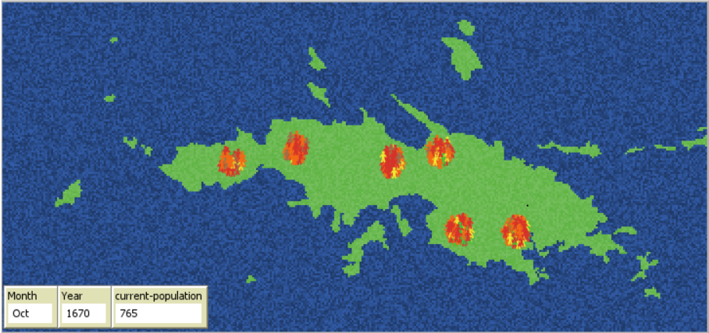
The University curricular unit
Linguistics, BA and MA (2-hour lecture & workshop)
What are models, and how do they embody ‘theory’?
What are the limitations of models, and how does that affect what we can know with a model?

Slide 3
What big question does the model answer?
What model assumptions must be there for the simulation to result in convergence on a common language?
The model / simulation is a virtual lab
Notes:
slide

Slide 4
Limitations
Remember: the model is a simplification of reality
What does it NOT include?
The lexical development of the population
Who do people communicate with?

Slide 5
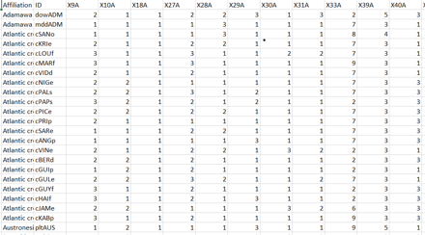
Development of language
How their language is represented
WALS-Features
Phonetic and Grammatical

Slide 6
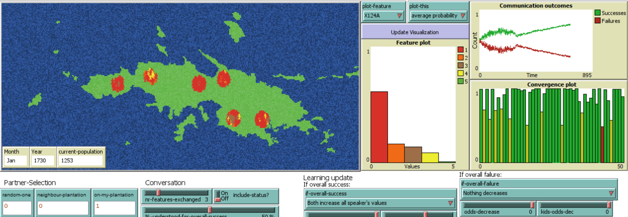
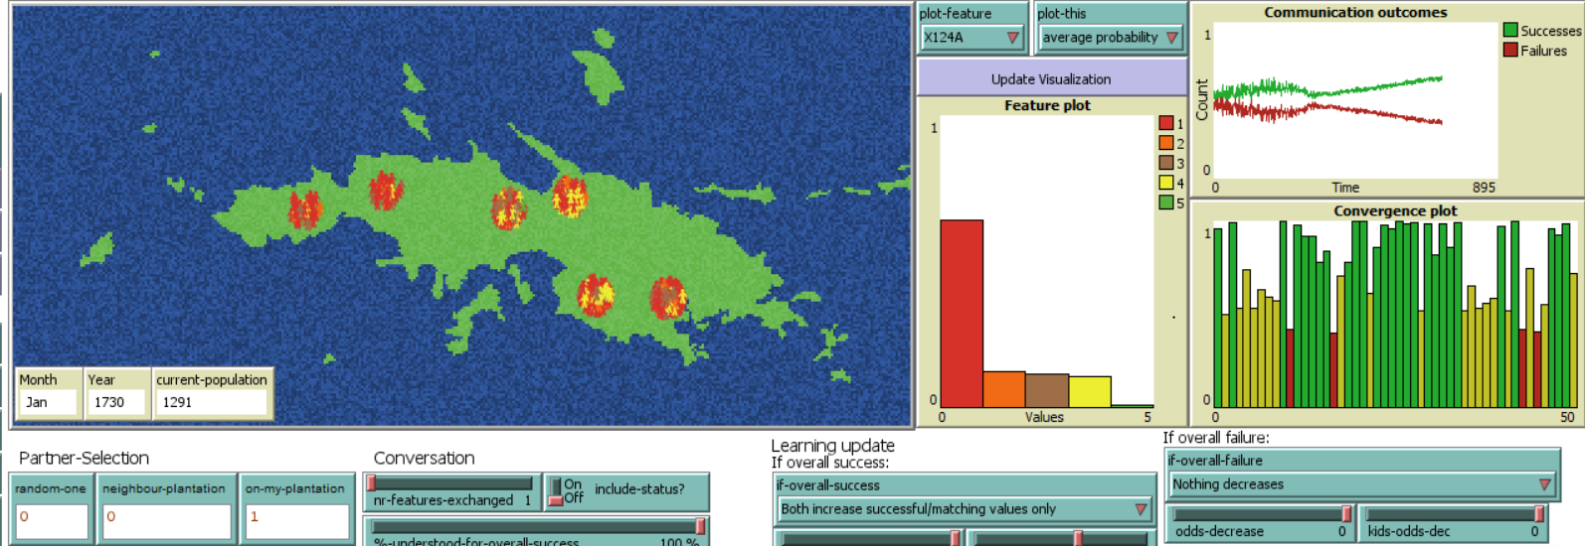
Comparing runs: partner choice
Only choosing partner from own plantation

Slide 7

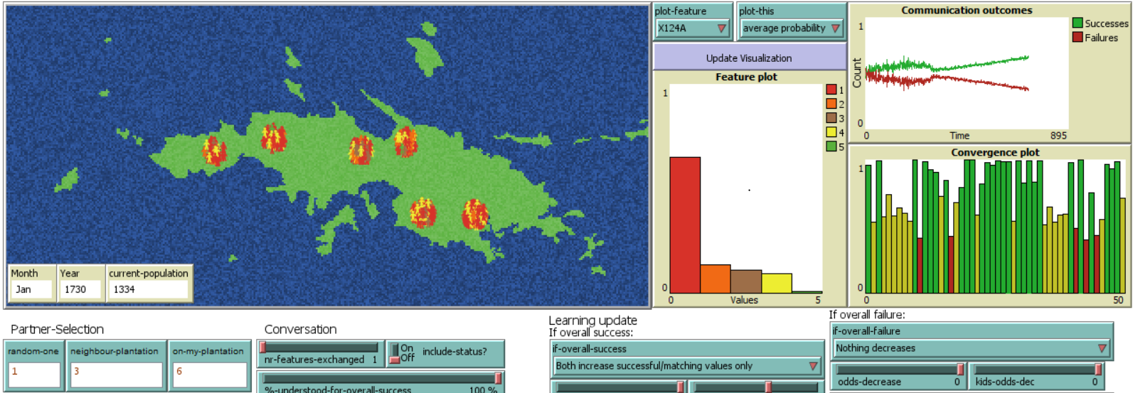
Comparing runs: partner choice
1/10 for choosing a random person on the island.
3/10 for choosing a random person from the closest plantation
6/10 for choosing a random person from own plantation

Slide 8
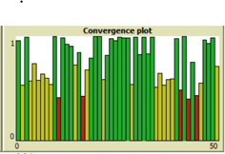
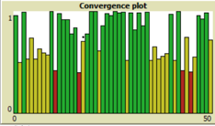
Comparing runs: partner choice
Partner from own plantation:
Partner from own, random and neighbour plantation:
Pretty much the same thing

Slide 9
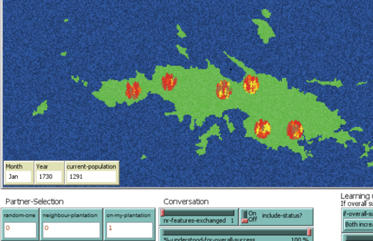
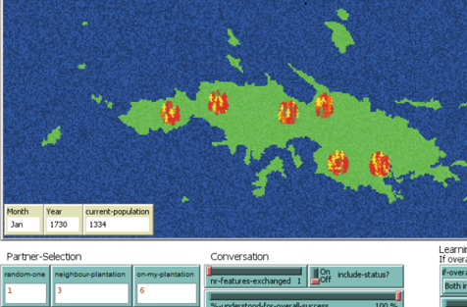
Comparing runs: partner choice
Partner from own plantation:
Partner from own, random and neighbour plantation:
Walz-Feature level adoption for each plantation
More general spread of Walz-Feature levels

Slide 10
Centre for
Educational Development

